Slide 1
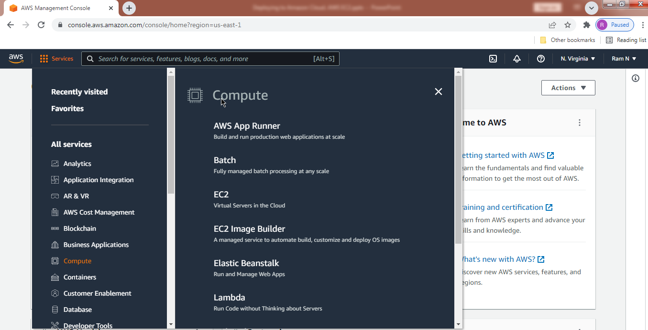
Spring Boot - Deploying to Amazon Cloud. AWS EC2
https://console.aws.amazon.com/console/home?region=us-east-1

Slide 2
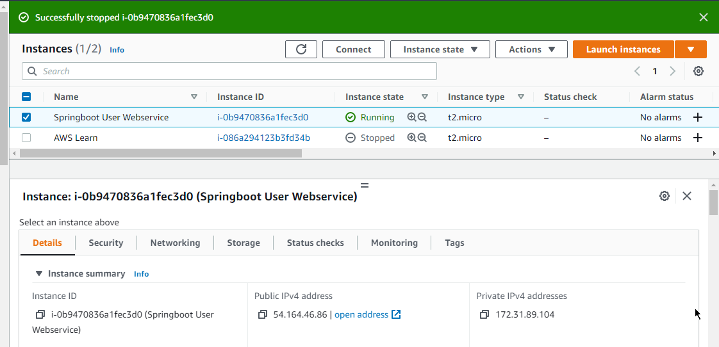
Spring Boot - Deploying to Amazon Cloud. AWS EC2
Startup Your Own Amazon EC2 Linux Server

Slide 3
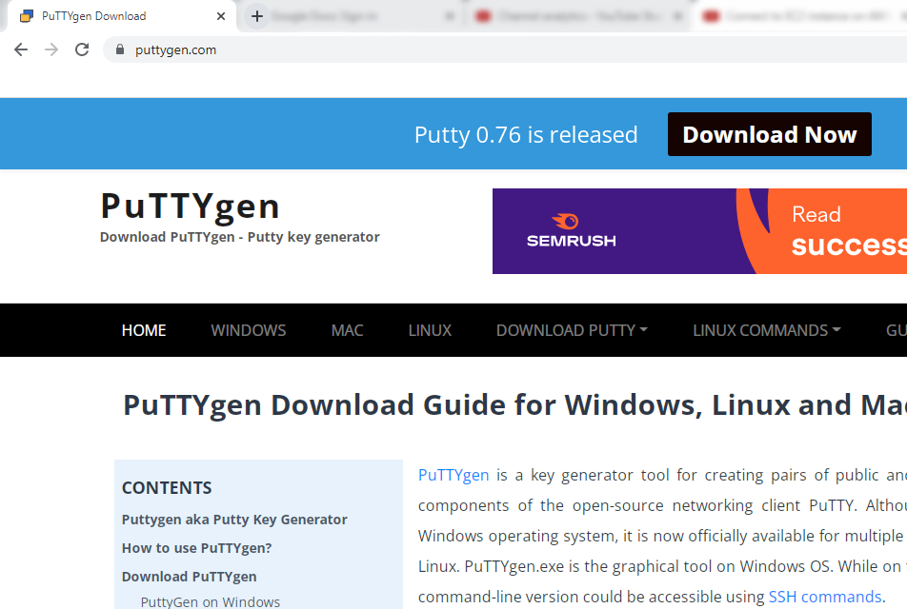
Spring Boot - Deploying to Amazon Cloud. AWS EC2
How to Connect to EC2 instance on AWS using PUTTY?
https://www.puttygen.com/

Slide 4
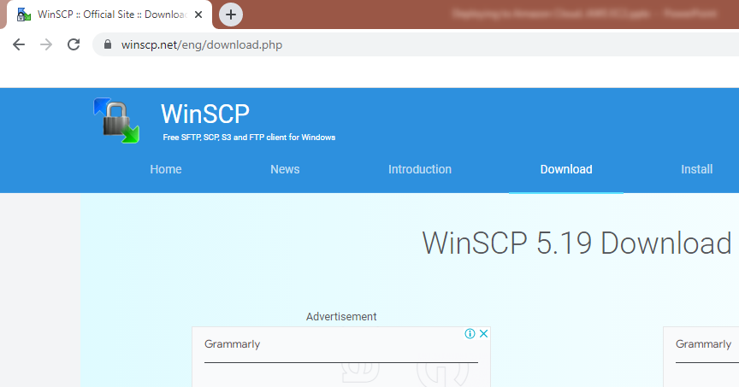
Spring Boot - Deploying to Amazon Cloud. AWS EC2
How to Connect to EC2 instance on AWS by FTP using WinSCP?
https://winscp.net/eng/download.php

Slide 5
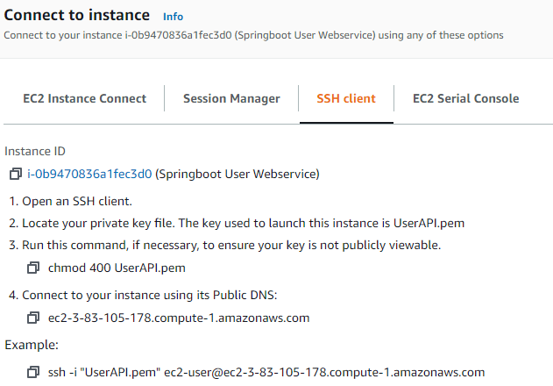
Spring Boot - Deploying to Amazon Cloud. AWS EC2
How to Connect to EC2 instance via SSH?
Linux Machine
SSH
Amazon EC2 Instance

Slide 6

Spring Boot - Deploying to Amazon Cloud. AWS EC2
How to Update EC2 Server Software Packages and Update Java?
sudo yum update
[ec2-user@ip-172-31-89-104 ~]$ java -version
[ec2-user@ip-172-31-89-104 ~]$ yum list java*
[ec2-user@ip-172-31-89-104 ~]$ sudo yum install java-1.8.0

Slide 7
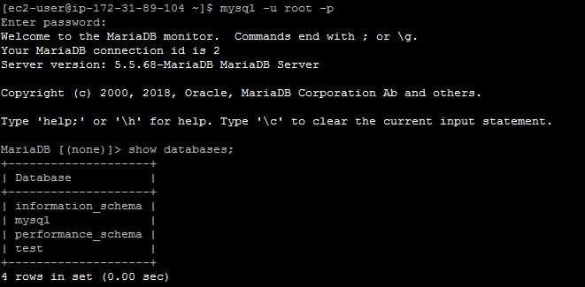
Spring Boot - Deploying to Amazon Cloud. AWS EC2
How to download and Install MariaDB on EC2 Linux Server?
[ec2-user@ip-172-31-89-104 ~]$ yum list mariadb*
[ec2-user@ip-172-31-89-104 ~]$ sudo yum install mariadb-server.x86_64
[ec2-user@ip-172-31-89-104 ~]$ sudo systemctl start mariadb
[ec2-user@ip-172-31-89-104 ~]$ sudo systemctl enable mariadb

Slide 8
Spring Boot - Deploying to Amazon Cloud. AWS EC2
How do I reset the MariaDB root password on an Amazon EC2 instance?
By default, MariaDB 5.5 on Amazon Linux 2 doesn't have a root password. If you create a root password for MariaDB and then lock yourself out of your database, you must reset the root password.
1. Verify that you have a recent snapshot of the volume(https://docs.aws.amazon.com/AWSEC2/latest/UserGuide/ebs-creating-snapshot.html#ebs-create-snapshot%20:%20Creating%20Amazon%20EBS%20Snapshots%20-%20Creating%20a%20Snapshot) on which the MariaDB data directory resides. You can recreate the volume from this snapshot, if needed.
Stop the MariaDB service:
sudo systemctl stop mariadb
3. Start MariaDB in safe mode:
sudo mysqld_safe --skip-grant-tables --skip-networking &
4. Log in to the MariaDB monitor:
mysql -u root
5. Update your MariaDB root password:
UPDATE mysql.user SET Password = PASSWORD('new_password_here') WHERE User = 'root';
The output looks like this:
Query OK, 1 row affected (0.00 sec)
Rows matched: 1 Changed: 1 Warnings: 0

Slide 9
Spring Boot - Deploying to Amazon Cloud. AWS EC2
How do I reset the MariaDB root password on an Amazon EC2 instance?
6. Flush the privileges to reload the grant tables. Your new password takes effect after the reload.
FLUSH PRIVILEGES;
7. Exit the MariaDB monitor:
exit
8. Stop the MariaDB process:
sudo kill `sudo cat /var/run/mariadb/mariadb.pid`
Note: The process might take a few seconds to terminate.
9. Start the MariaDB service:
sudo systemctl start mariadb
10. Test your new MariaDB root password:
mysql -u root -p

Slide 10
Spring Boot - Deploying to Amazon Cloud. AWS EC2
How to download & Install Apache Tomcat on AWS EC2 Linux Server?
https://tomcat.apache.org/download-90.cgi
[ec2-user@ip-172-31-89-104 ~]$ cd /tmp
[ec2-user@ip-172-31-89-104 tmp]$ pwd
/tmp
[ec2-user@ip-172-31-89-104 tmp]$
You can use the wget command to download the Tomcat zip file to the /tmp directory, a temporary folder location.
wget https://dlcdn.apache.org/tomcat/tomcat-9/v9.0.62/bin/apache-tomcat-9.0.62.tar.gz
$ sudo mkdir /opt/tomcat
$ tar -xf apache-tomcat-9.0.62.tar.gz
$ sudo mv apache-tomcat-9.0.62 /opt/tomcat/

Slide 11
Spring Boot - Deploying to Amazon Cloud. AWS EC2
How to download & Install Apache Tomcat on AWS EC2 Linux Server?
$ sudo chown -R ec2-user: /opt/tomcat
$ sudo sh -c 'chmod +x /opt/tomcat/apache-tomcat-9.0.62/bin/*.sh'
$ cd /opt/tomcat/apache-tomcat-9.0.62/bin
$ ./catalina.sh start
$ ./catalina.sh stop

Slide 12
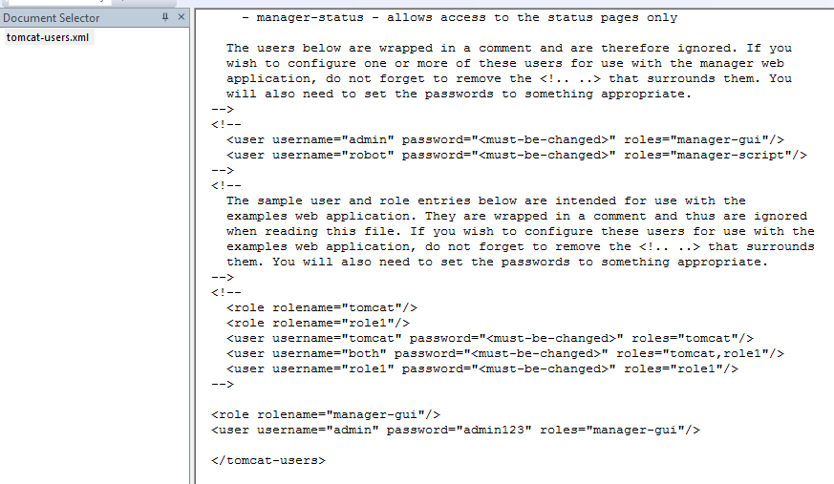
Spring Boot - Deploying to Amazon Cloud. AWS EC2
How to Configure Apache Tomcat Users?

Slide 13
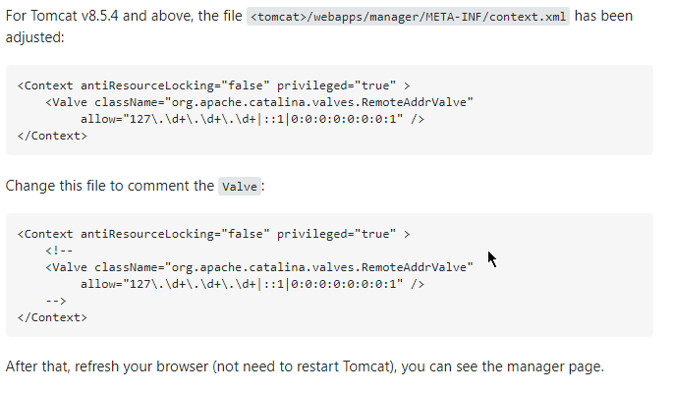
Spring Boot - Deploying to Amazon Cloud. AWS EC2
How to Access Tomcat Manager App from different host?
By default the Host Manager is only accessible from a browser running on the same machine as Tomcat. If you wish to modify this restriction, you'll need to edit the Host Manager's context.xml file.

Slide 14
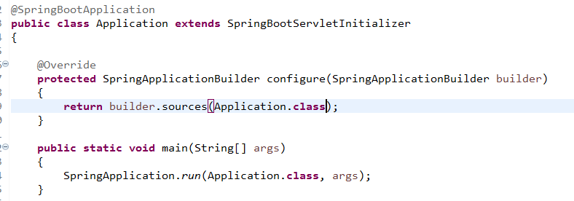
Spring Boot - Deploying to Amazon Cloud. AWS EC2
How to Generate WAR file and deploy Our Web Service App on Apache Tomcat?
Tomcat Server in EC2 Instance
user-app-ws.war

Slide 15
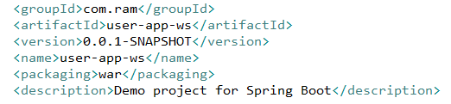
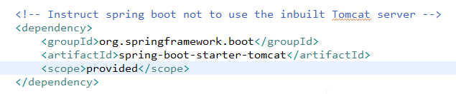
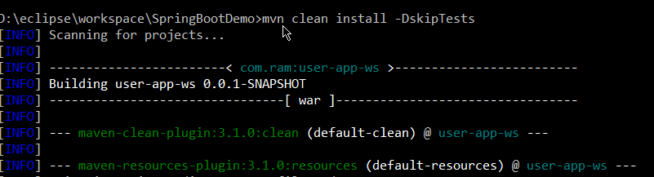
Spring Boot - Deploying to Amazon Cloud. AWS EC2
How to Generate WAR file and deploy Our Web Service App on Apache Tomcat?
To skip the test case during maven clean install i used -DskipTests paramater in following command
>mvn clean install -DskipTests

Slide 16
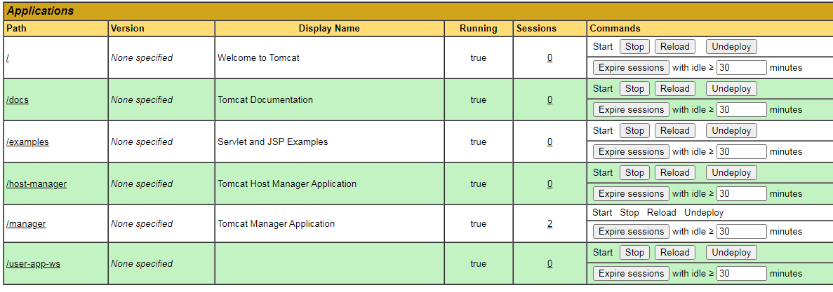
Spring Boot - Deploying to Amazon Cloud. AWS EC2
How to Generate WAR file and deploy Our Web Service App on Apache Tomcat?
$ sudo systemctl start mariadb
$ mysql -u root
$ mysql -uroot –proot
> SHOW DATABASES;
> CREATE DATABASE org_db;
> use org_db;
> show tables;

Slide 17
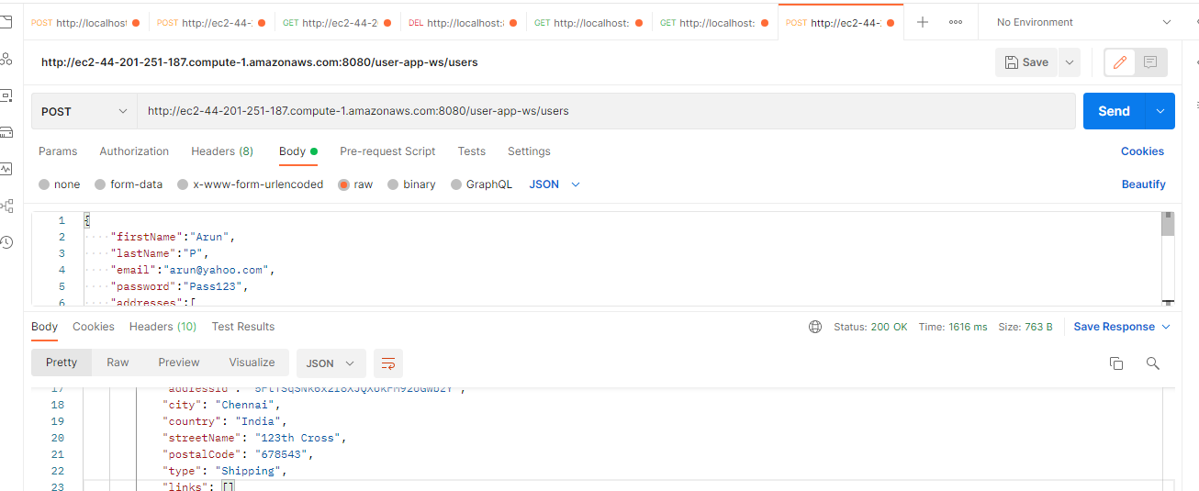
Spring Boot - Deploying to Amazon Cloud. AWS EC2
How to send HTTP Request to a Webservice Deployed on a Remote EC2 Server?

Slide 18
How do I stop PuTTY inactive? | How do you fix PuTTY inactive? | How to keep SSH connections alive?
Why is my PuTTY inactive?
When you cannot type anything in your PuTTY window and you see "(inactive)" in your PuTTY window's title bar, it means that your connection is inactive (has been dropped by the server).
How do you fix inactive PuTTY?
If you go to your putty settings -> Connection and set the value of "Seconds between keepalives" to 30 seconds this should solve your problem.

Slide 19
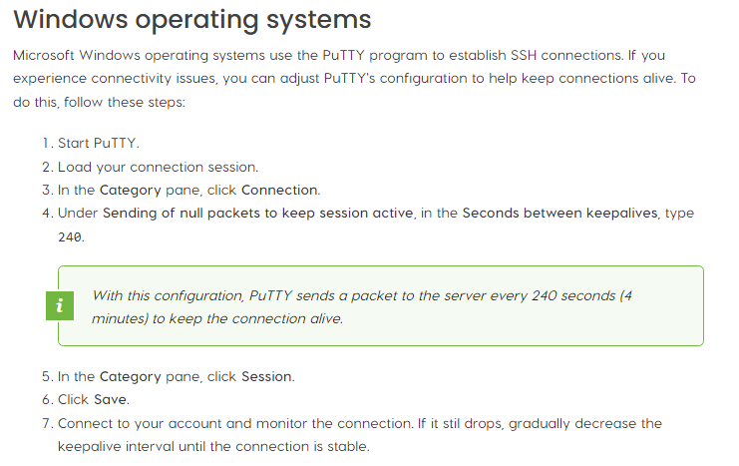
How do I stop PuTTY inactive? | How do you fix PuTTY inactive? | How to keep SSH connections alive?

Slide 20
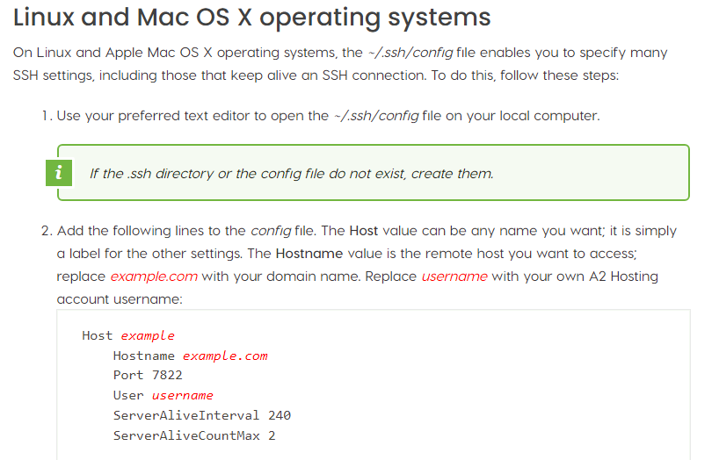
Linux and Mac OS X operating systems | How to keep SSH connections alive?

Slide 21
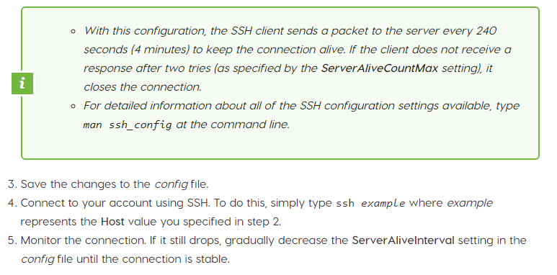
Linux and Mac OS X operating systems | How to keep SSH connections alive?

Slide 22
Linux and Mac OS X operating systems | How to keep SSH connections alive?
[ec2-user@ip-172-31-89-104 ~]$ man ssh_config
[ec2-user@ip-172-31-89-104 ~]$ pwd
/home/ec2-user
[ec2-user@ip-172-31-89-104 ~]$ cd .ssh
[ec2-user@ip-172-31-89-104 .ssh]$ pwd
/home/ec2-user/.ssh
[ec2-user@ip-172-31-89-104 .ssh]$ touch config
[ec2-user@ip-172-31-89-104 .ssh]$ ls
authorized_keys config
[ec2-user@ip-172-31-89-104 .ssh]$ vi config
[ec2-user@ip-172-31-89-104 .ssh]$ vi config
[ec2-user@ip-172-31-89-104 .ssh]$ vi config
[ec2-user@ip-172-31-89-104 .ssh]$ ssh example
Bad owner or permissions on /home/ec2-user/.ssh/config
[ec2-user@ip-172-31-89-104 .ssh]$ sudo ssh example
ssh: Could not resolve hostname example: Name or service not known
[ec2-user@ip-172-31-89-104 .ssh]$
Host example
Hostname example.com
Port 7822
User username
ServerAliveInterval 240
ServerAliveCountMax 2

Slide 23
How to Install Tomcat using Yum Package Manager, Configure Apache Tomcat Users and Deploy the WAR file in Amazon EC2 Instance?
$ sudo yum list tomcat*
$ sudo yum install tomcat tomcat-admin-webapps tomcat-docs-webapp tomcat-javadoc tomcat-jsvc tomcat-webapps tomcatjss
$ sudo service tomcat start
$ sudo service tomcat stop
$ sudo service tomcat restart
$ sudo systemctl start tomcat
$ sudo systemctl stop tomcat
$ whereis tomcat
$ sudo systemctl restart tomcat
$ sudo chown -R ec2-user: /var/log/tomcat

Slide 24
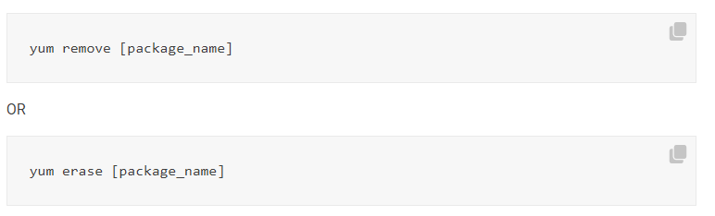
How to Uninstall Tomcat using Yum Package Manager Amazon EC2 Instance? | How to Uninstall or Remove Packages from Linux OS?
To remove a package from Linux, use the following yum commands:
Note:
Only root users and users added to the sudousers group have permission to install and remove packages in Linux OS.
Uncesscerary packages slow down system performance and take up storage space. If specific software isn’t being used, then it’s best to remove it, and doing so is easy.

Slide 25
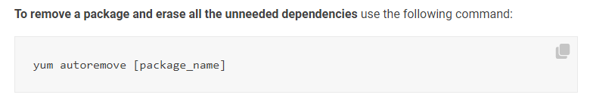
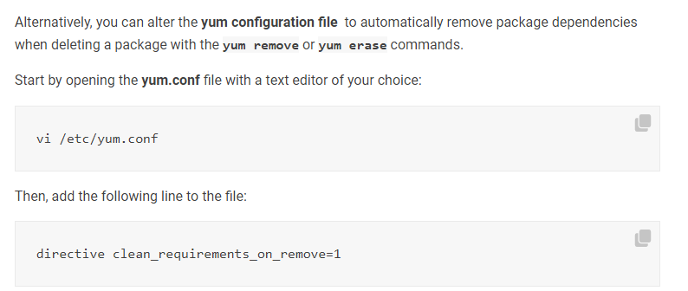
How to Uninstall Tomcat using Yum Package Manager Amazon EC2 Instance? | How to Uninstall or Remove Packages from Linux OS?
Package dependencies are binaries, libraries, and modules on which software rely on. When installing software, it will automatically download and store the required dependencies.
In most cases, deleting software from the local package manager will also erase its dependencies (unless other programs require them).
Still, there are instances in which these dependencies have to be removed manually.
How to Remove Packages with Dependencies Using Yum?

Slide 26
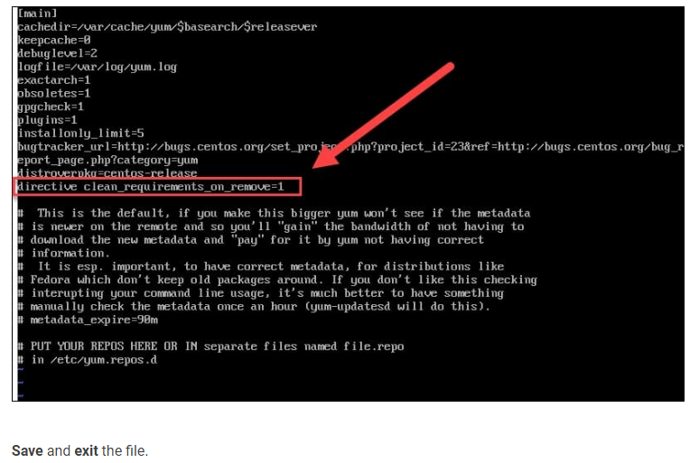
How to Uninstall Tomcat using Yum Package Manager Amazon EC2 Instance? | How to Uninstall or Remove Packages from Linux OS?

Slide 27
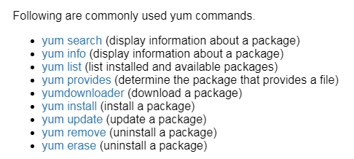
How to Uninstall Tomcat using Yum Package Manager Amazon EC2 Instance? | How to Uninstall or Remove Packages from Linux OS?
In case you need to delete a package but are unsure of its exact file name, you can use one of the following command.
The output will list all installed packages with the specified phrase found in the file name.
After you have the exact name of the package you want to erase, you can uninstall it from your Linux OS.
yum list | grep [package_name]

Slide 28
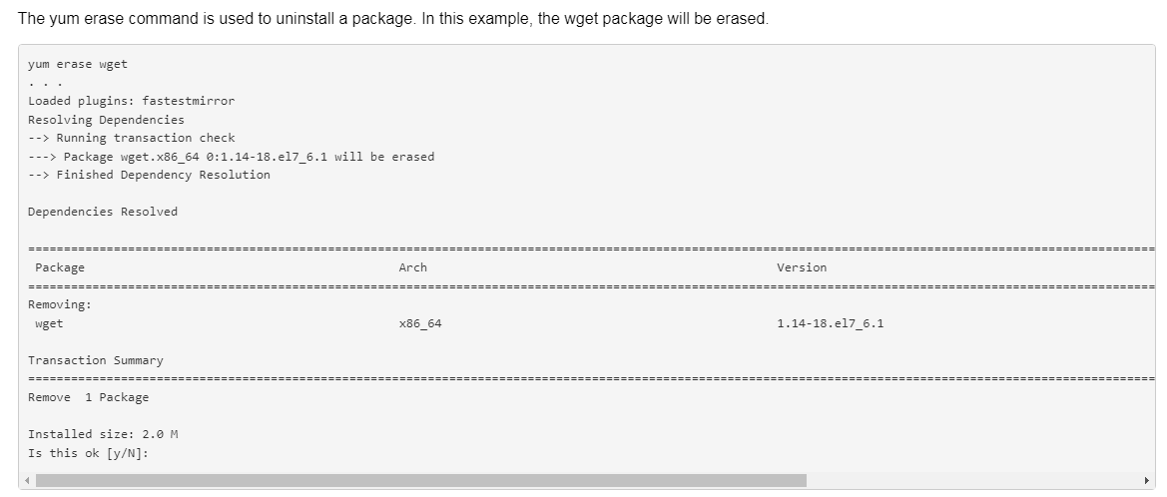
How to Uninstall Tomcat using Yum Package Manager Amazon EC2 Instance? | How to Uninstall or Remove Packages from Linux OS?

Slide 29
How to Uninstall MariaDB using Yum Package Manager in Amazon EC2 Instance? | How to Uninstall or Remove Packages from Linux OS?
To remove a package from Linux, use the following yum commands:
Note:
Only root users and users added to the sudousers group have permission to install and remove packages in Linux OS.
Uncesscerary packages slow down system performance and take up storage space. If specific software isn’t being used, then it’s best to remove it, and doing so is easy.

